Slide 1
AZIZ RIDANE
PROJECT DISPLAY

Slide 2
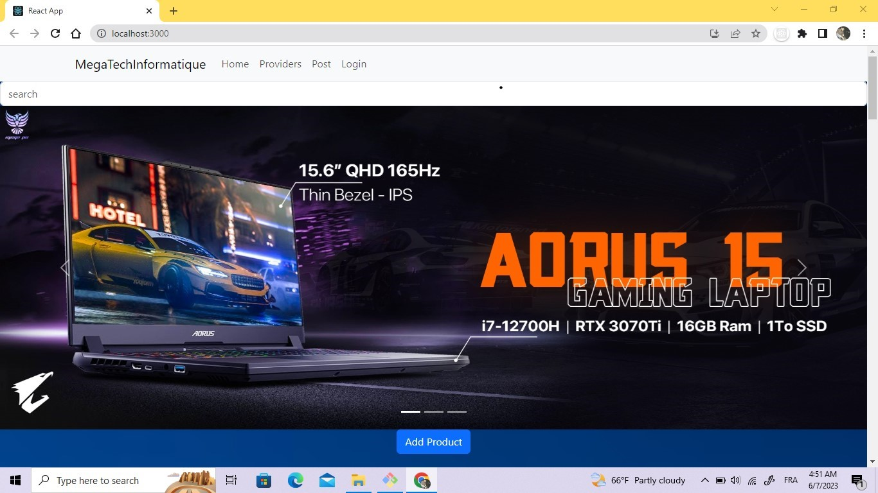
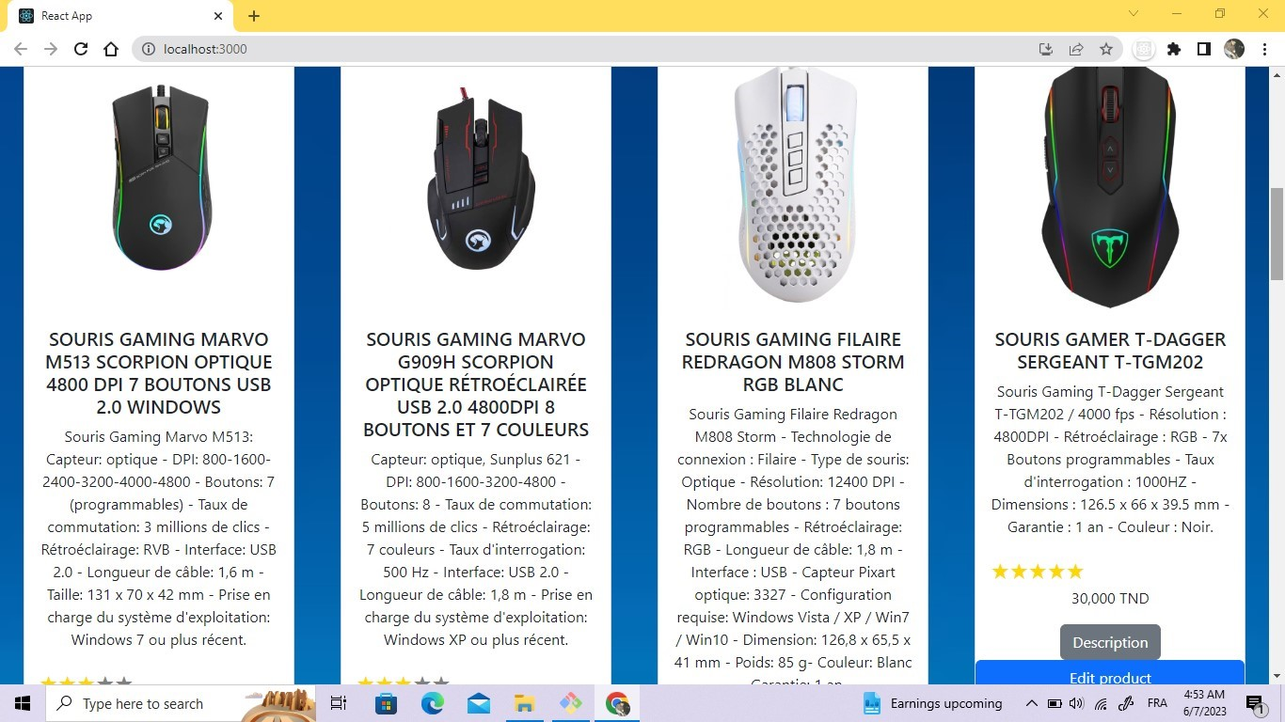
I import a navigation from boosttrap and and the cards i create a button from boosttrap for adding product and button for delete and one for edit the product

Slide 3
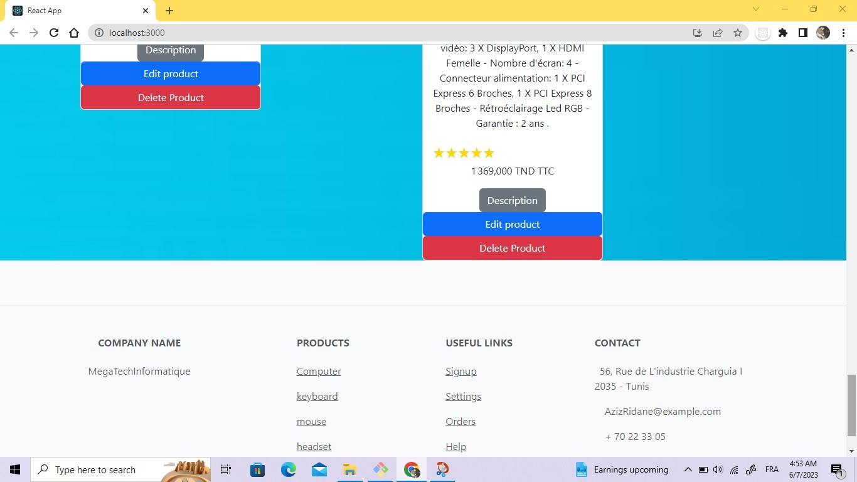
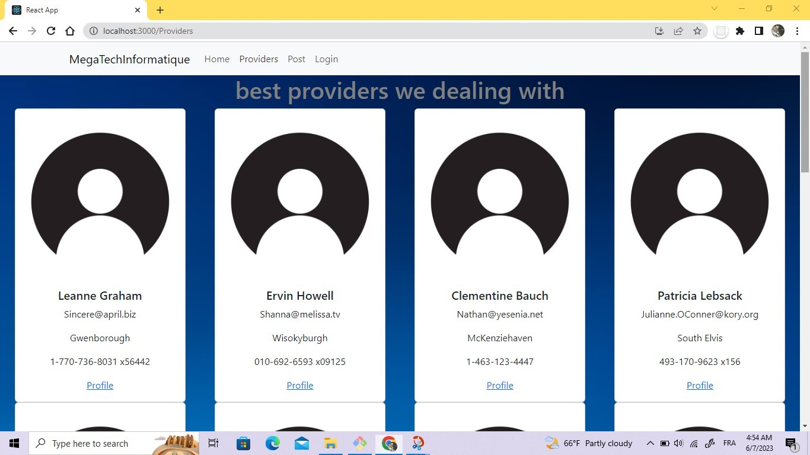
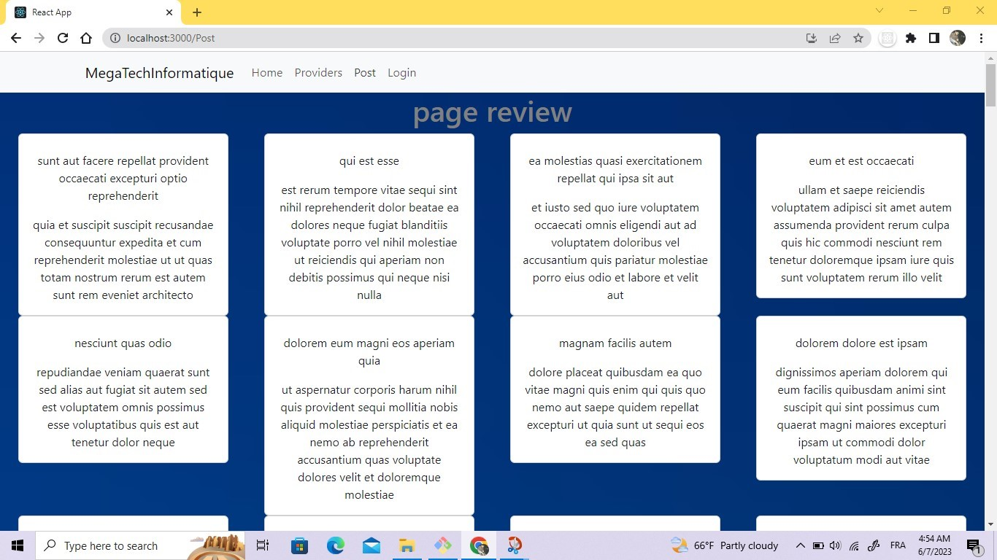
For the provider page and page review i use api from https://jsonplaceholder.typicode.com/ and cards from boostrap and footer

Slide 4
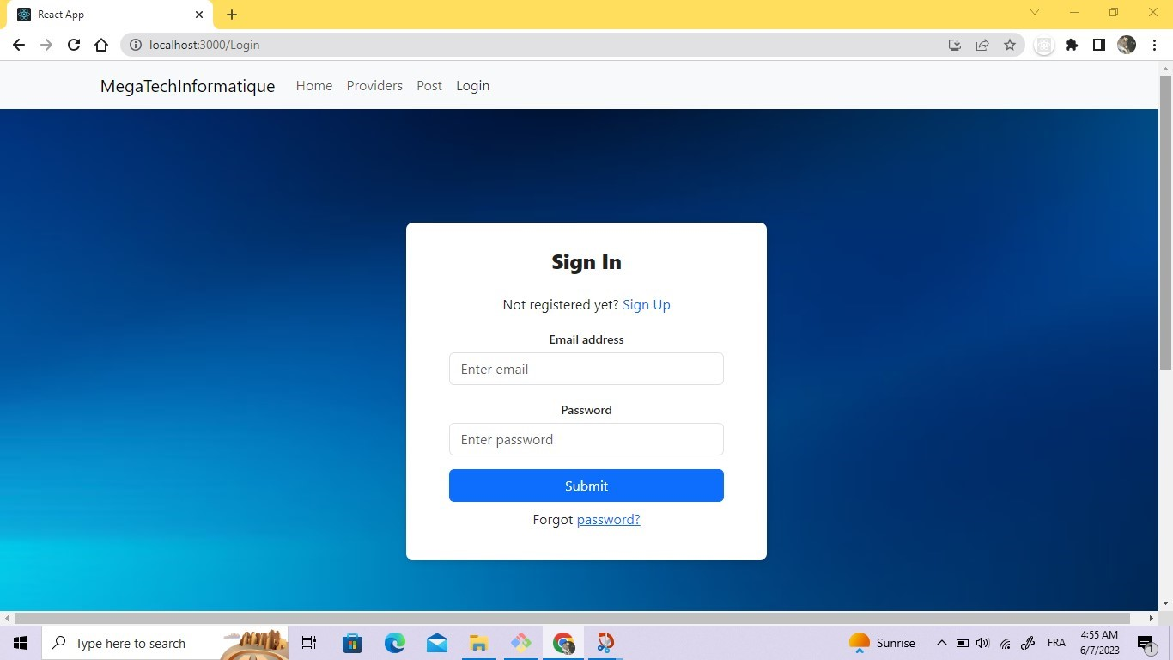
For the log in page i create a sign in form

